Slide 1
What Results in Death? Analysis of Social Conflict in Africa, 1990–2011
Matthew Boyas
STAT 222: MA Capstone Midterm Presentation
March 17, 2014

Slide 2
Presentation Outline
Background on Nuremberg
Introduction to Social Network Analysis
Generating a Network
Data Analysis
Conclusions
Questions

Slide 3
What is Nuremberg?
International Military Tribunal (IMT)
November 20, 1945 – October 1, 1946
Try 21 of the major Nazi party leaders for crimes against humanity and war crimes
Agree to assign individual criminality (US-led plan)
No true historical precedent
Lots of Allied disagreements about how to punish Germany
Notes:
Moscow Declaration on 1 November 1943
“Major criminals whose offenses have no particular geographical location … will be punished by a joint decision of the governments of the Allies.”
Lieutenant-Colonel Murray Bernays, War Department chief of the Special Projects Office of the Personnel Branch
Vs. summary execution

Slide 4
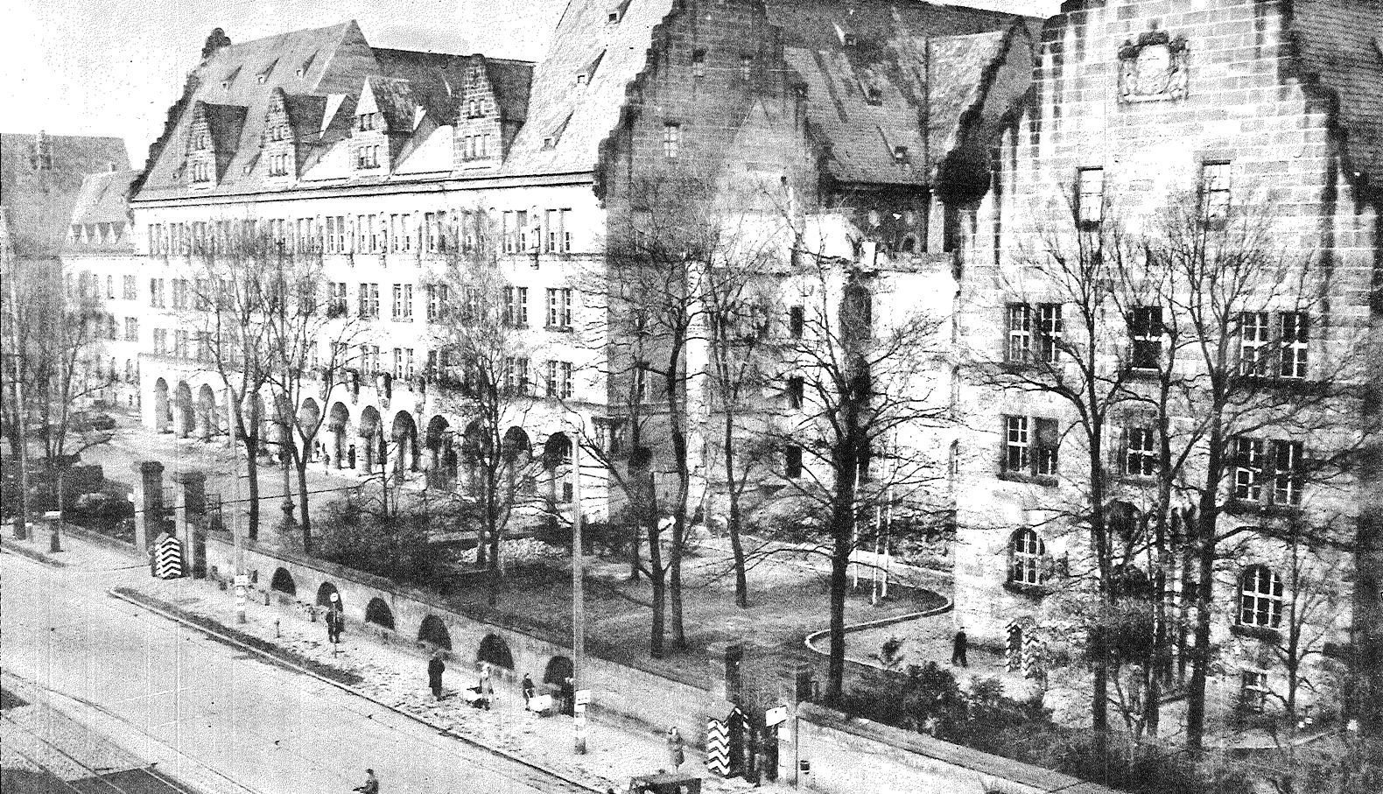
Palace of Justice
Notes:
Why Nuremberg?
American occupation zone
Ideological seat of Nazi regime

Slide 5
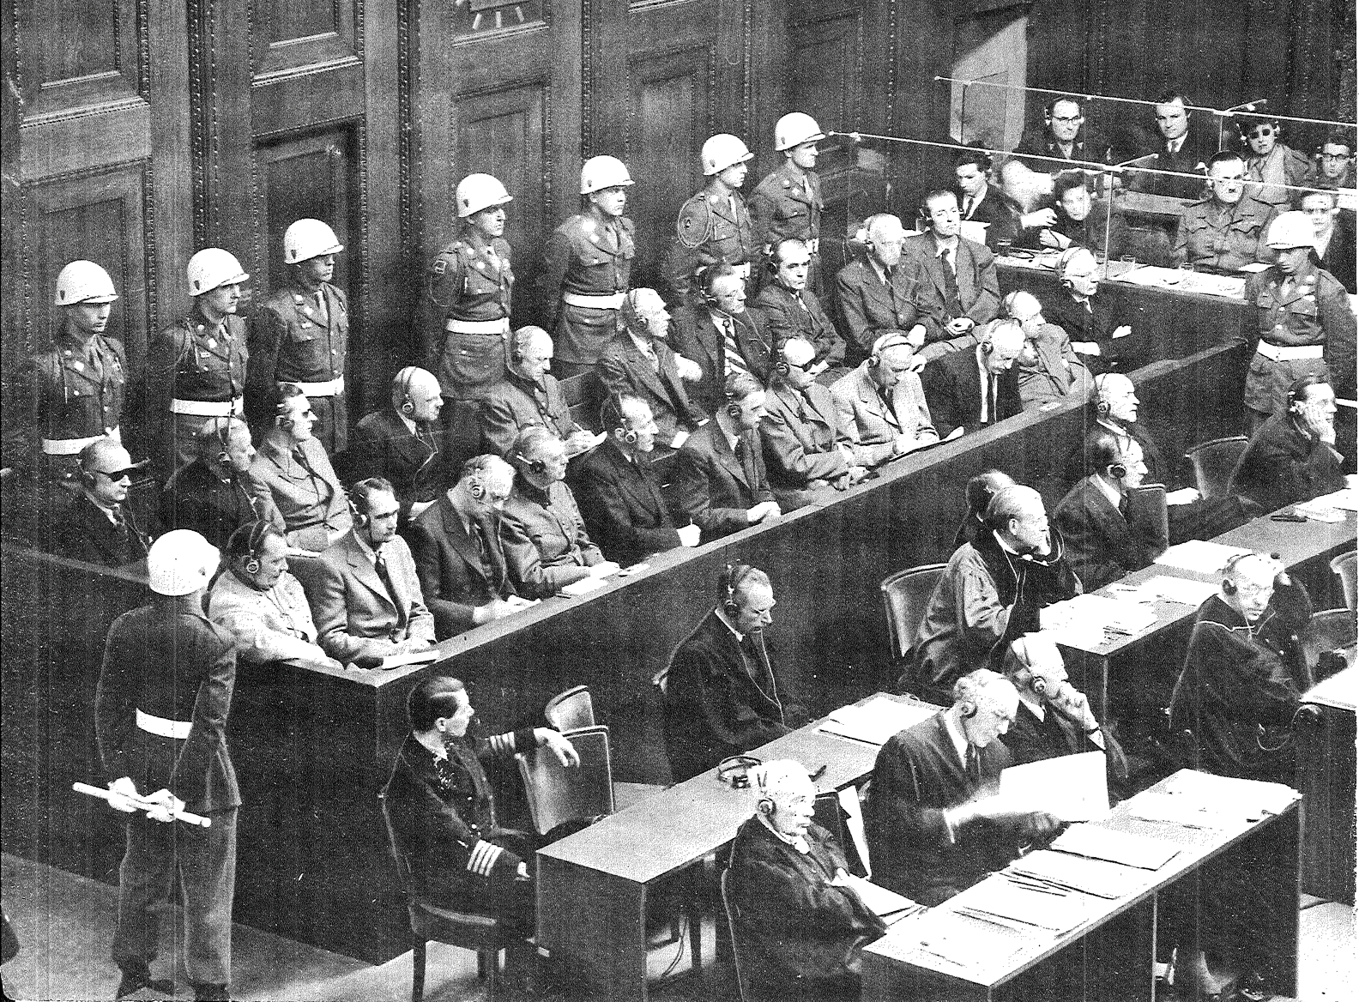
Nuremberg Defendants
Notes:
21 defendants
Sir Hartley Shawcross (UK prosecutor): most of the defendants had chosen themselves
Extensive trial proceedings (“citadel of boredom” rebecca west)
12 out of 21 defendants were sentenced to death
three were acquitted
the rest received varying imprisonment sentences.
Establishes precedent (ICTY, ICTR, ICC)

Slide 6
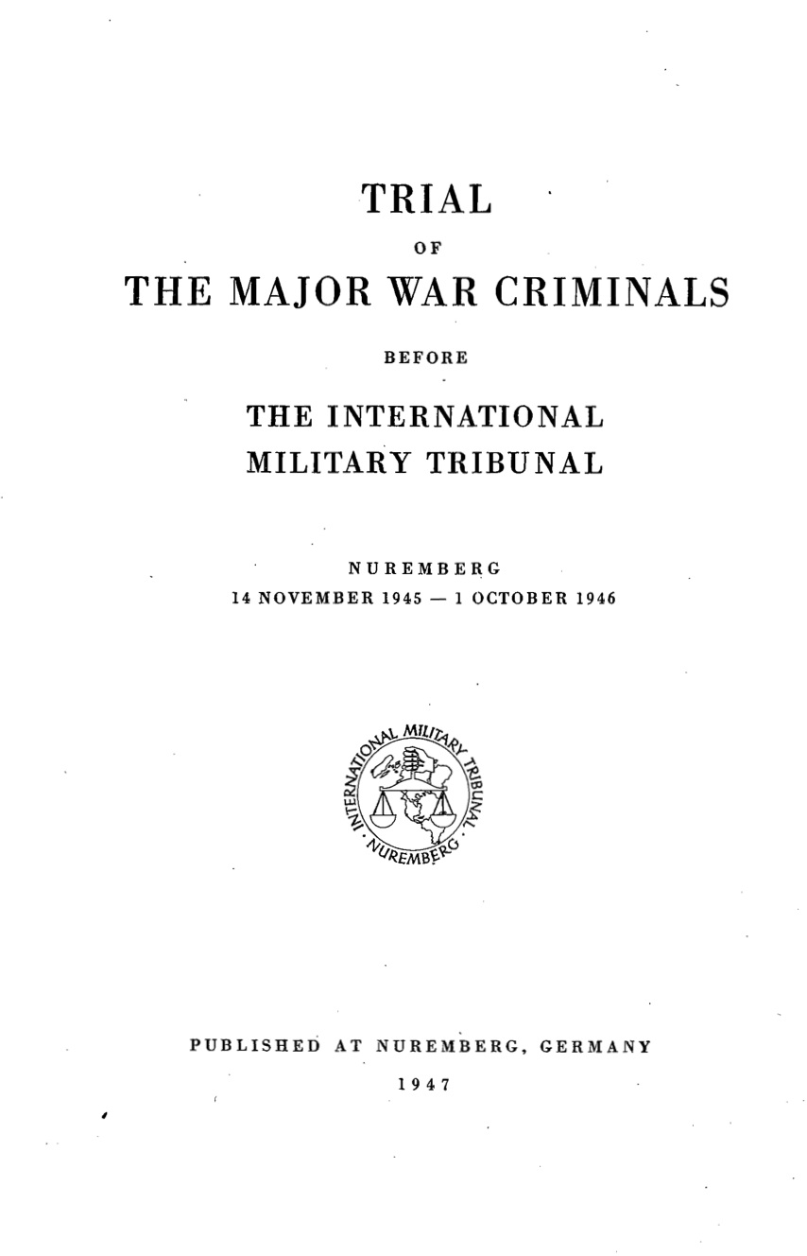
The Blue Series
Trial proceedings published in book form
The Blue Series
22 volumes of text
2 volumes of index (subject & name)
18 volumes of documentation

Slide 7
Social Network Analysis
Has origins in Gestaltist psychology
Began to rapidly advance in the computing era
Harrison White, Harvard University
Relational data
Typically encoded in data matrices
Nodes: the main units in a network (often people)
Edges: links between the nodes
Data stored in matrices
Notes:
Relational data: “contacts, ties, and connections…which relate one agent to another and so cannot be reduced to the properties of the agents themselves.”
Vs. attribute data
The sum is greater than the individual parts (gestaltism)

Slide 8
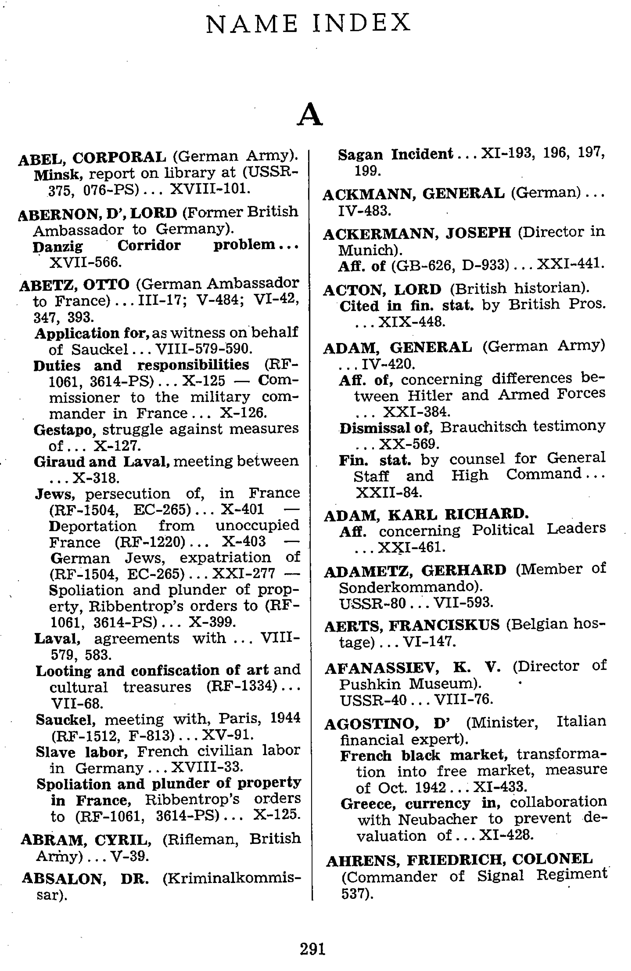
Network Creation Idea
Name index of The Blue Series
Generate links if two people are referenced on the same page
EX: IV-406
Similar algorithm to Levine study of Central American Monitor (c. 1990)
Data preparation obstacles
3,454 nodes
Notes:
PDF index – need select all content into text files
Optical Character Recognition (OCR) inconsistencies
Manual audits of selected text
Python script to parse the index
Stata script to generate links
Matlab script to manipulate the data matrices

Slide 9
Analysis Questions
Viable method for analysis?
Structure of the trial process?
New information about the Third Reich?
Notes:
Academic exercise

Slide 10
Connectedness
Notes:
Are all of the nodes in the network linked?
Run algorithm to analyze connected sets; involves matrix multiplication
140 total connected sets in network
95 single unconnected nodes
1 set of 3224 connected nodes
44 sets in between

Slide 11
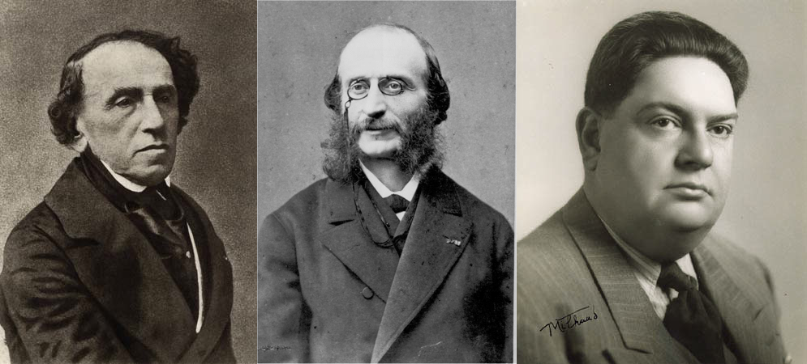
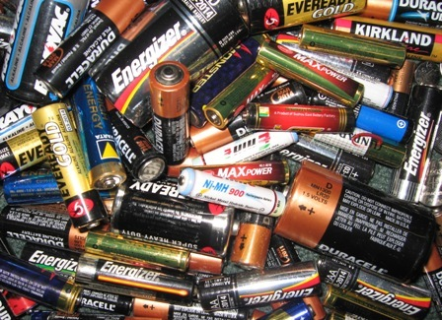
Analysis of Smaller Sets
Small groups of people
Connected by profession, importance to the trial, and/or country of origin
Two examples:
Notes:
(1)
Jewish composers
Example of literary censorship (biographies)
(2)
Von Holtzendorff, owner of a battery factory
Dr. Leon Laval, a Luxembourg engineer
Dr. Saager, an official in the Reich Ministry of Economics
Saager-developed business colonization plans
Holtzendorff takes over luxembourger laval’s factory

Slide 12
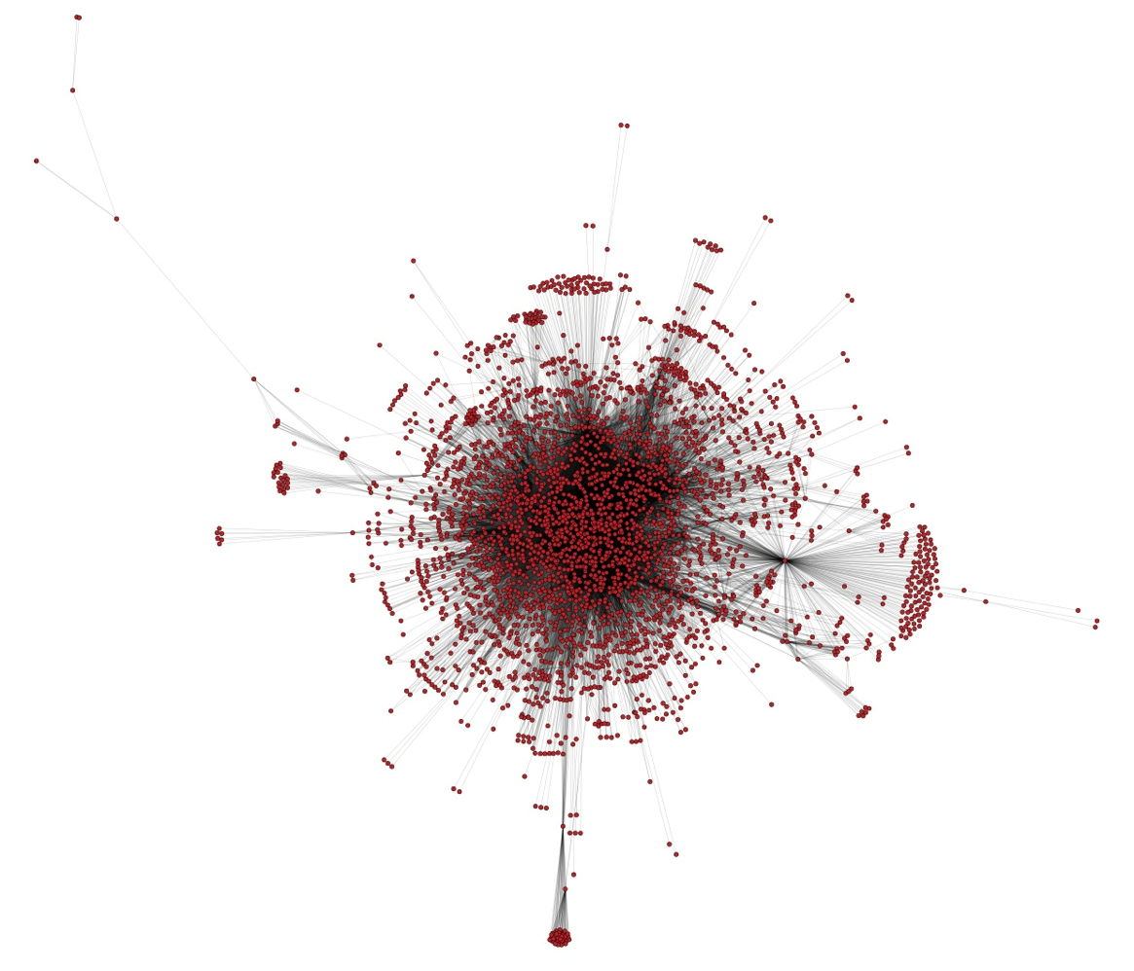
Analysis of Larger Set
Notes:
Yifan Hu force-directed algorithm
Variant of typical methods
Nodes = electrically charged particles that repel each other
edges = springs that pull the particles inwards
Balance the forces to get a graph
Avg clustering: 0.822 (0 to 1 scale)
Avg path length: 2.918
VERY TIGHTLY CONNECTED

Slide 13
Who is Most Important?
Node Number | Name | Eigenvector Centrality Ranking | Betweenness Centrality Ranking | Degree Ranking | Who?
1259 | HIRT, PROFESSOR DR. | 1 | 4 | 1 | SS-Sturmbannfuehrer; professor at Strasbourg University
980 | GOERING, HERBERT | 2 | 3 | 2 | IMT Defendant
1477 | KEIT | 3 | 6 | 4 | Ministerial Counsellor, Chief of Chancellery of Government General
1242 | HILGER | 4 | 8 | 6 | German Foreign Office official
1433 | KALLUS, HEINZ KARL | 5 | 1 | 3 | Ministerial Counsellor in the Ministry of Economics
1960 | MAUSER | 6 | 7 | 5 | Sonderfuehrer in prisoner of war camp at Smolensk
2502 | REYNAUD, PAUL | 7 | 5 | 7 | French Prime Minister
Notes:
Eigenvector centrality: importance based on how important the neighbors are
Betweenness: number of shortest paths
Degree: number of links
Low-level government workers
Goering notable exception; Dr Hirt was notorious, but also working within an established framework
Reynaud was not effective, fled and was held by Germans
Do it by weighted degree? What we would expect. Hitler and defendants.

Slide 14
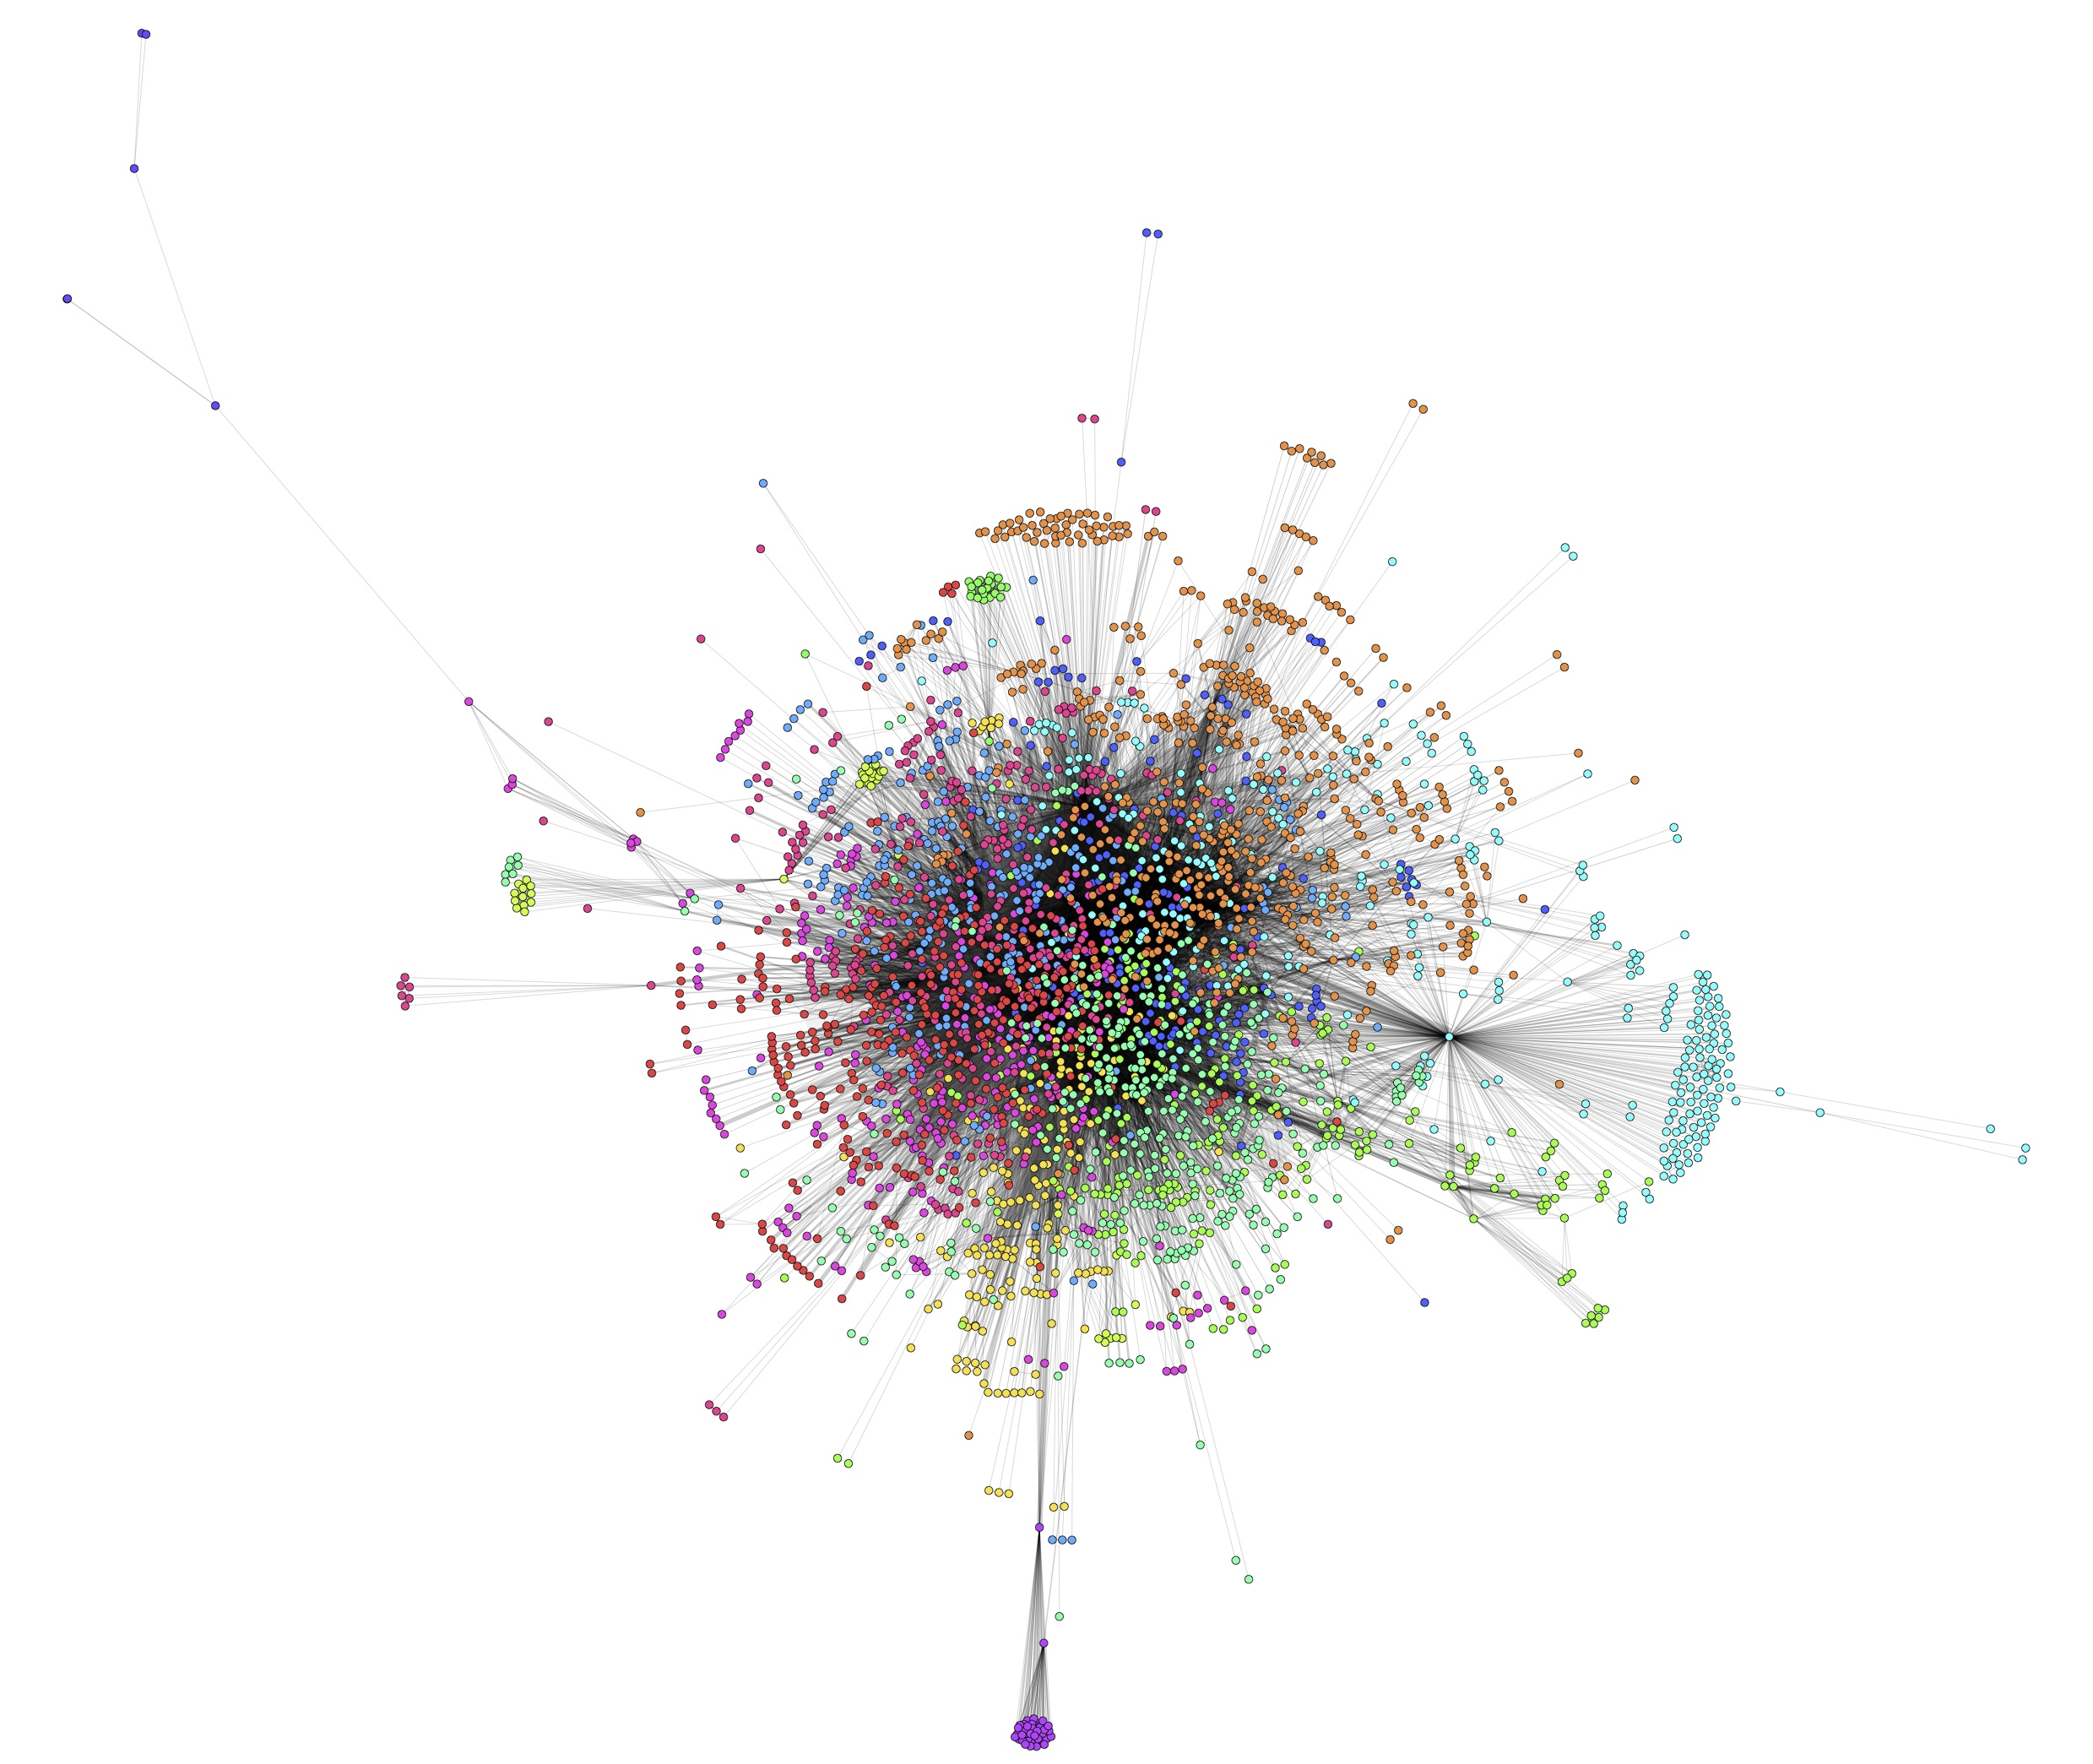
Modularity Partitions
Notes:
Modularity: compares to a random network to find unexpected clusters
14 communities
No real overarching pattern
Russian writer Leo Tolstoy and Belgian hostage Franciskus Aerts

Slide 15
Centroid Scaling
Notes:
“Joint-Space Analysis of ‘Pick-Any’ Data: Analysis of Choices from an Unconstrained Set of Alternatives” (1979)
“estimate[e] coordinates [of each node] such that each set of coordinates is centered with respect to the other”
14 dimensions
Scatter plots
Large numbers of nodes at origin.
Who is on the outskirts?
Dim1: specific event with the SS and failed execution of prisoners
Dim5: psychiatric review committee
Either small trial artifacts or specific event-based testimony

Slide 16
Conclusions
Network theory is viable analysis method
IMT is not US-dominated
Psychiatric review committee exists independently
Third Reich conclusions more limited
Low-level officials perhaps important

Slide 17
Future Work & Implications
Use other algorithms to continue to analyze clustering
Historical research to validate conclusions
This project shows glimmers of progress
Possible to turn text into quantifiable data
Implications for studying extensive amounts of text
Notes:
Network analysis used frequently in IR – treaty data, etc.
Now could be used to see textual relationships

Slide 18
Acknowledgements
Joel Levine
Steve Peterson
Shannon Draucker
Matthew Harding
Judy Danna
Dartmouth College Research Computing

